Slide 1
CLUB ACTIVITIES
SYSTEM ANALYSIS & DESIGN LAB
MEMBERS | ID
MD. ADNAN YOUNUS | 011 171 018
FAZLE RABBI FERDAUS | 011 172 120
SHAKIL MAHMUD | 011 142 120

Slide 2
Features
Online member recruitment
Club events and news
Event search by filters
Members information
Member event Registration
Volunteer registration
Create events and notices

Slide 3
Benchmarks
Volunteer for Bangladesh
MIT Event Calendar
Stanford University Event Calendar
Northwestern University Student Affairs
University of Delaware Events

Slide 4


Benchmark Analysis
Features | VBD | MIT | Stanford | Northwestern | Delaware | Our
Onlline member reqruitment
Event, notices/ news
Event search by filters
Members information
Member’s event registration
Volunteer registration
Create events & notices

Slide 5
Diagrams to be shown
Context diagram
Activity diagram
Data flow diagram
Use case diagram
State diagram
Swimlane Activity diagram
Sequence Diagram
Class Diagram

Slide 6
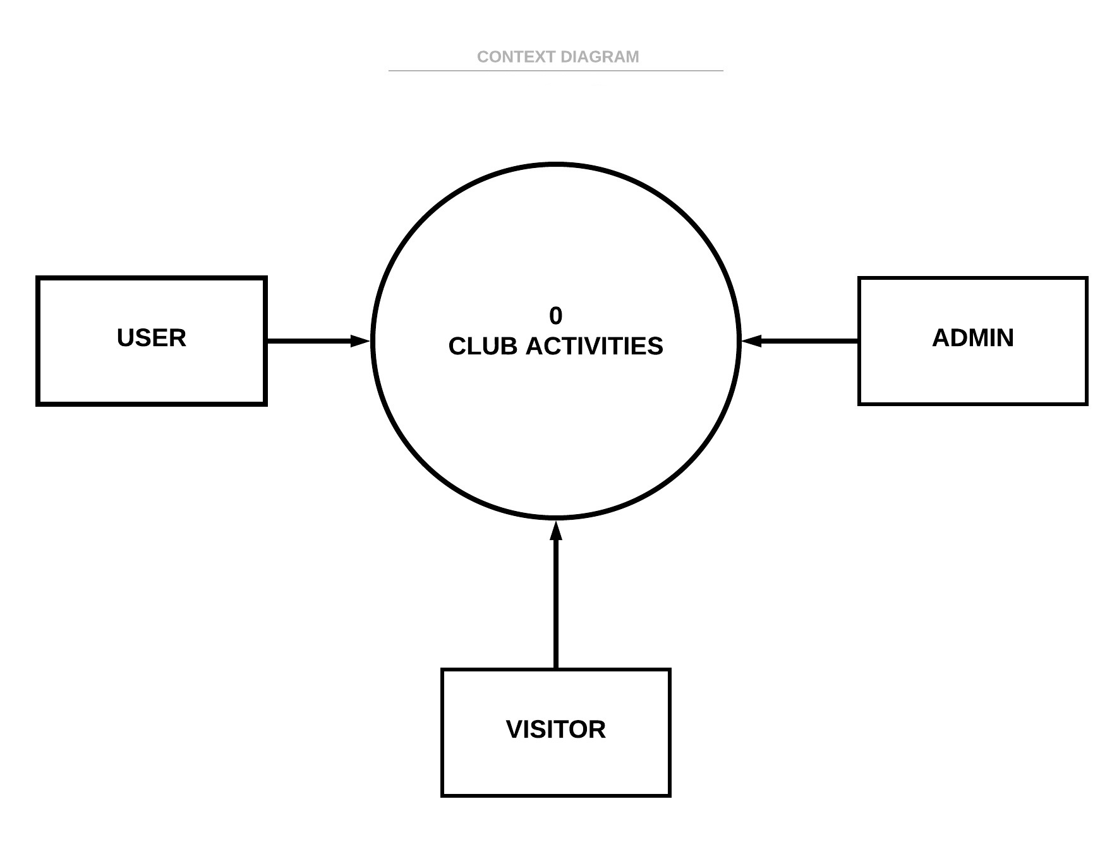
CONTEXT DIAGRAM

Slide 7
Chosen major features for activity diagram
Event & news creation
Event registration as volunteer or participant

Slide 8
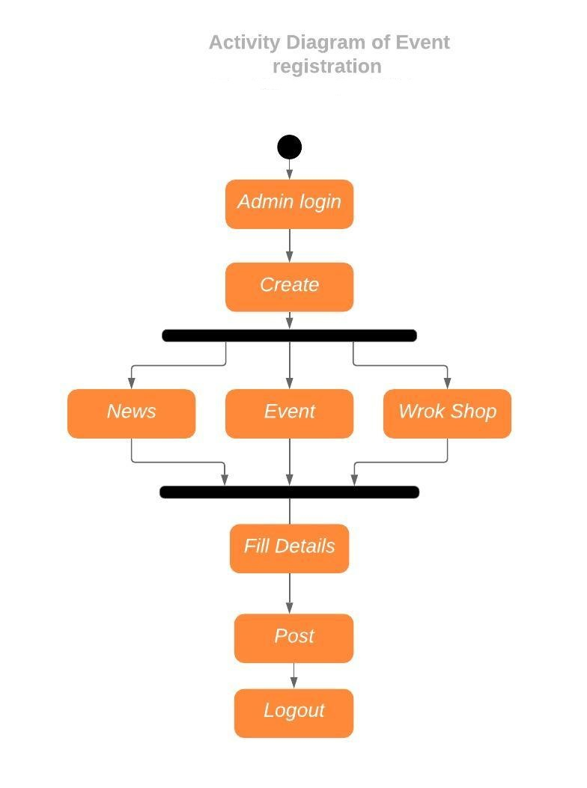
ACTIVITY DIAGRAM

Slide 9
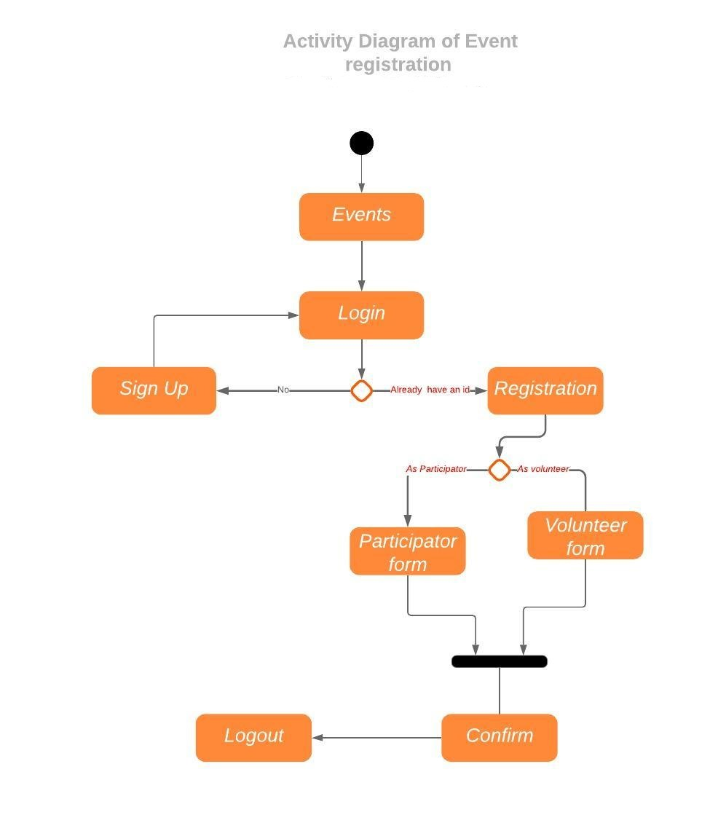
ACTIVITY DIAGRAM

Slide 10
Chosen major features for data flow diagram
Event & news creation
Event registration as volunteer or participant
Member recruitment

Slide 11
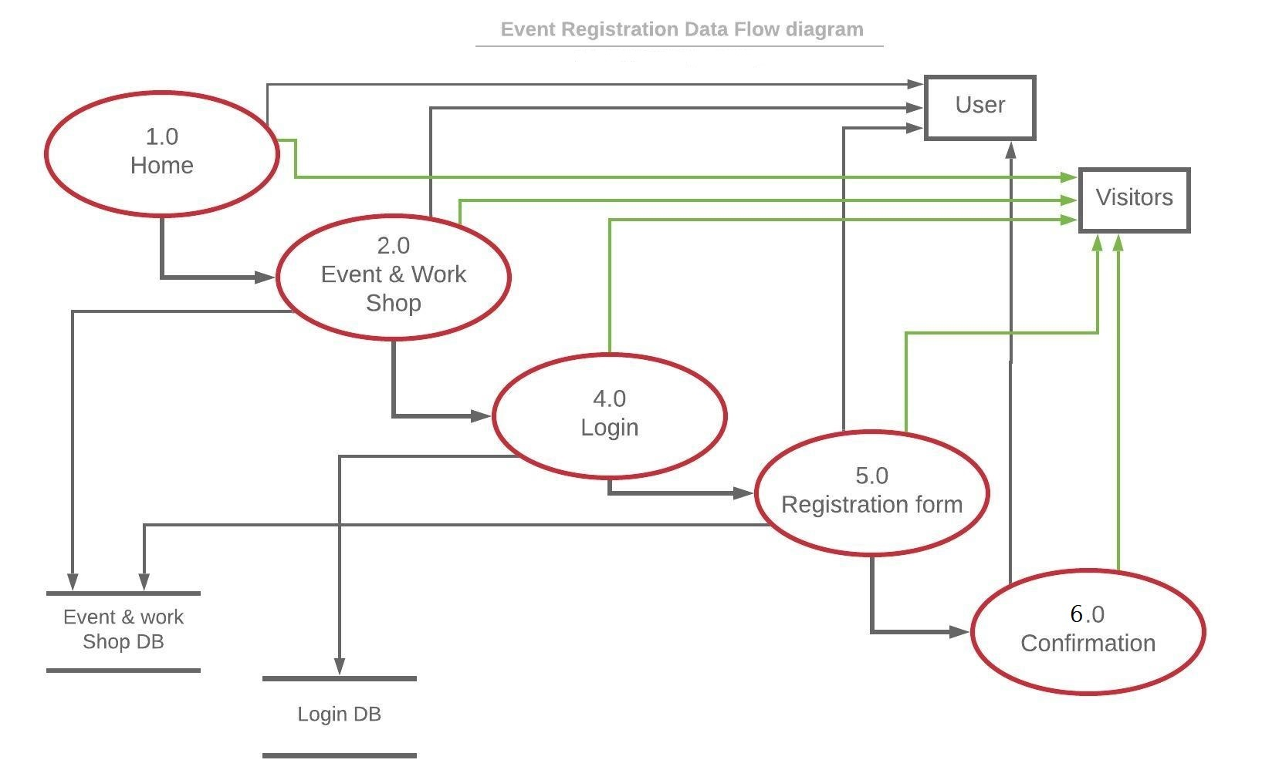
DATA FLOW DIAGRAM

Slide 12
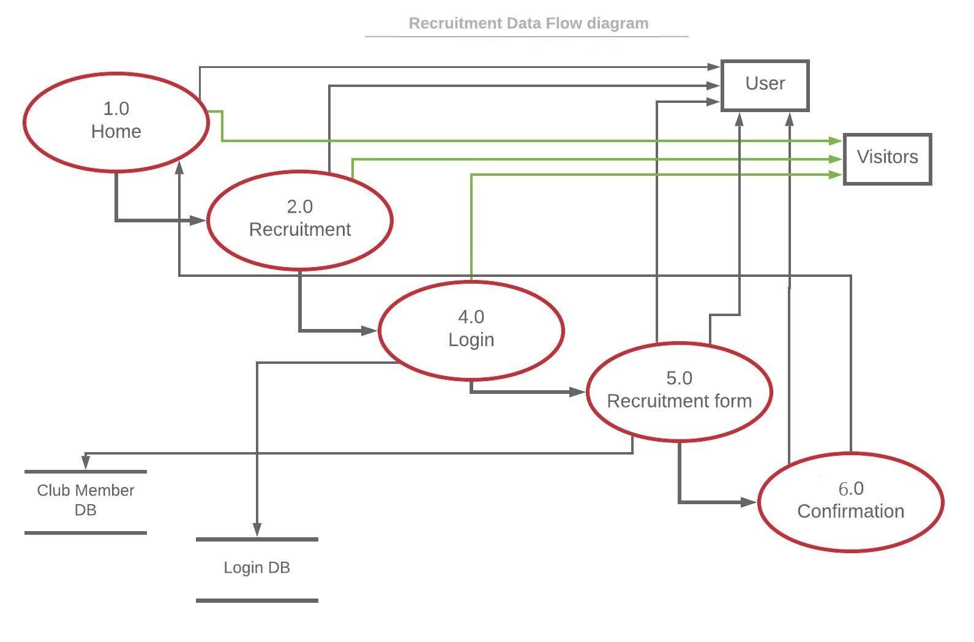
DATA FLOW DIAGRAM

Slide 13
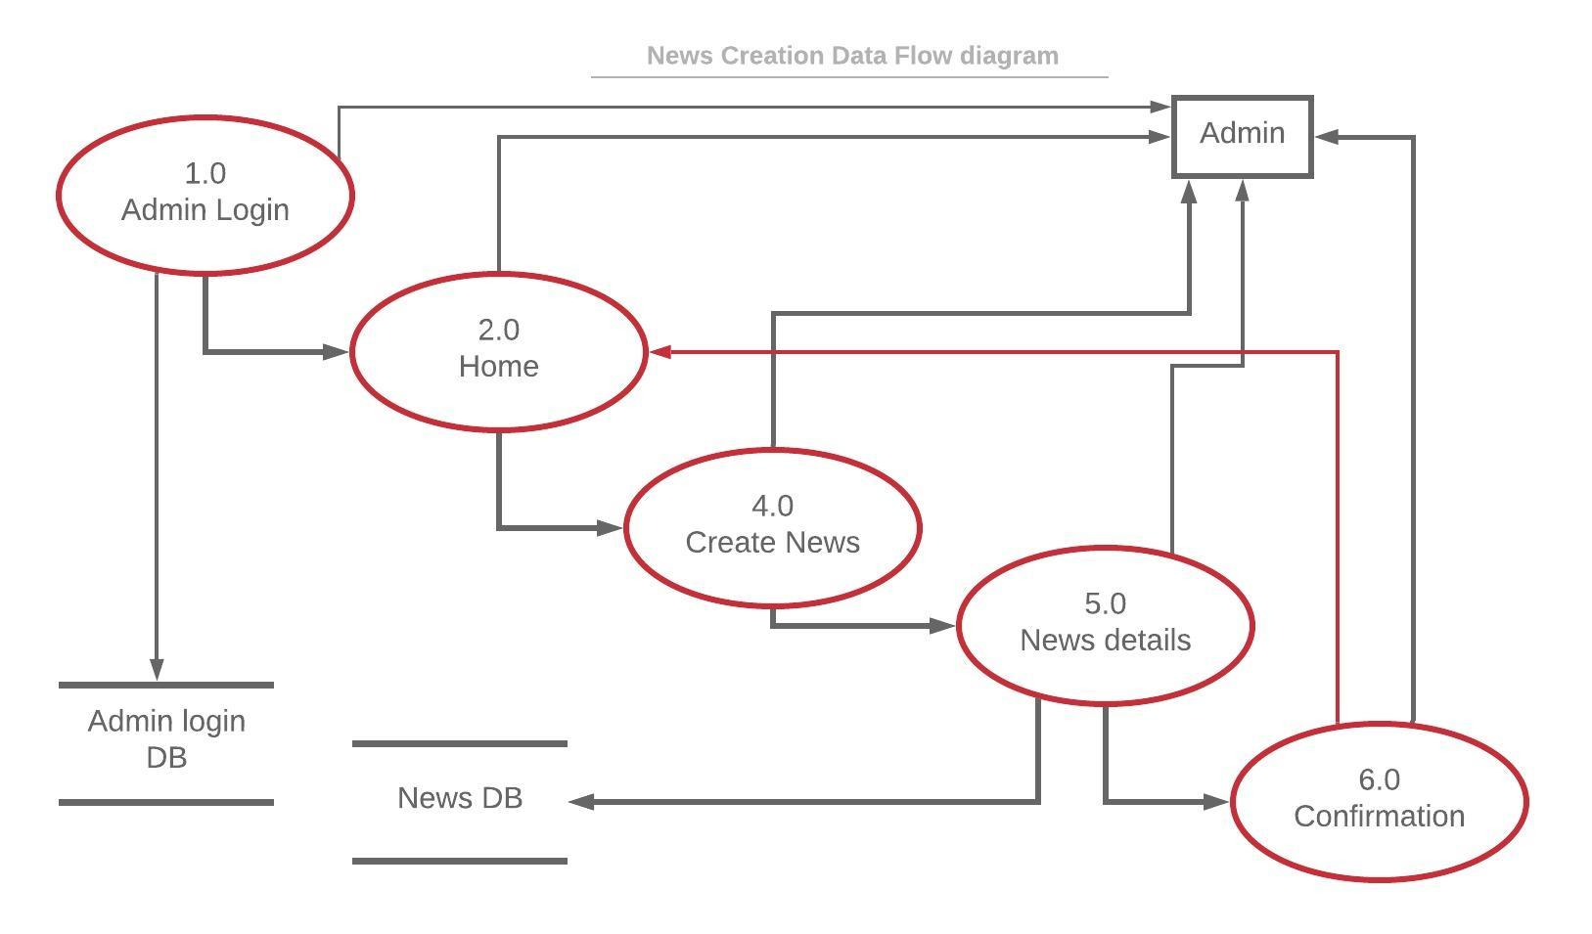
DATA FLOW DIAGRAM

Slide 14
USE CASE DIAGRAM

Slide 15
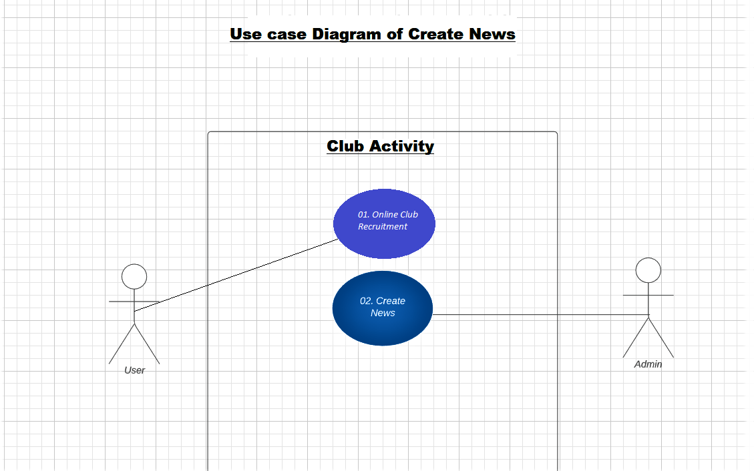

Slide 16
Use Case Descriptive
Use Case 01: Online club recruitment
Primary Actor: Student
Stakeholders and Interests:
1. Student: Wants to get successfully join in the desired club
2. Admin: Needs to make sure that the student has the username and password in order to log-in into the system

Slide 17
Pre Condition:
1. The student should be a authorized user, i.e. a student of UIU
2. Student should know the username and password for logging in.
Post Conditions:
1. The recruitment remains even when the student logs out
2. The changes are made in the database
3. The student can see himself/herself in the member list of the club that he/she joined.

Slide 18
Main Success Scenario
1. Student goes to the website
2. Student logs into the system using the username and password
3. Student navigates to the ”Online recruitment” page from the ”home page”
4. Student fill up the form , select desired club & click “Join” button
5. The student is recruited in the club.

Slide 19
Alternate Scenario
*a. The system may not respond
Solution: Wait for the system to respond
4a. Student may not find the club in the list
Solution: Student needs to contact the admin
Issues
1. If username or password is not correct. Error message will be shown

Slide 20
Use Case Descriptive
Use Case 02: Create News
Primary Actor: Admin
Stakeholders and Interests:
1. Student: Wants to see the news/notices of the clubs
2. Admin: Create the news/notices for the students with proper heading & description

Slide 21
Pre Condition:
1. Should be the authorized admin of the system
2. Admin should know the username and password for logging in.
Post Conditions:
1. The news remains even when the admin logs out
2. The changes are made in the database
3. The student can see the news in the news & event page

Slide 22
Main Success Scenario
1. Admin goes to the website
2. Admin logs into the system using the username and password
3. Admin selects the ”Create News” option from “Create news/event” page
4. Admin fill up the form with proper data & click “Create” button
5. The news is created

Slide 23
Alternate Scenario
*a. The system may not respond
Solution: Wait for the system to respond
Issues
1. If username or password is not correct. Error message will be shown

Slide 24
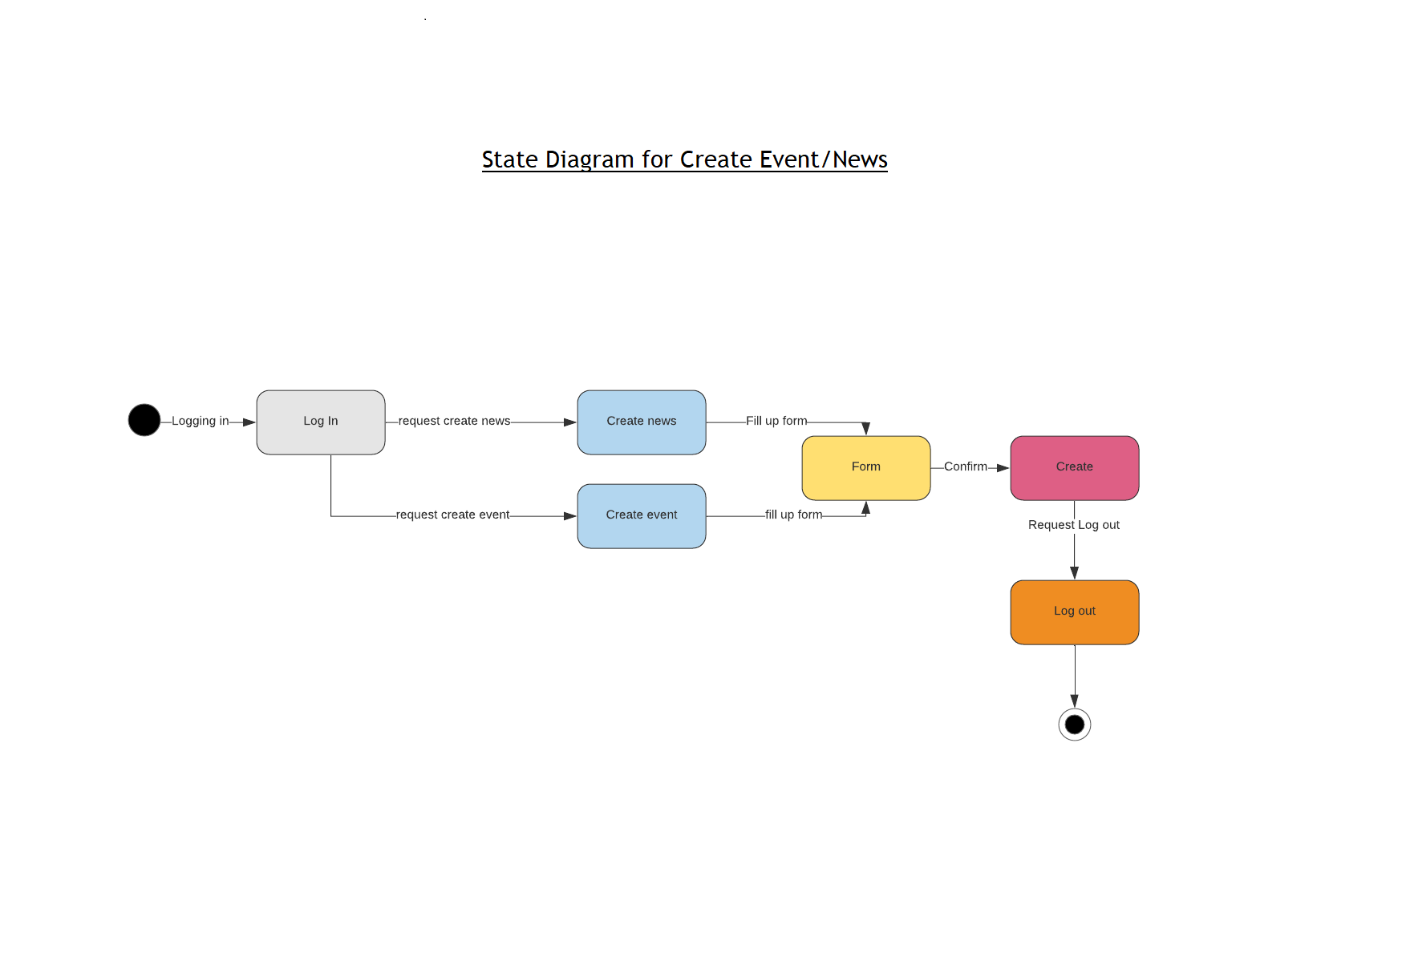
State Diagram

Slide 25
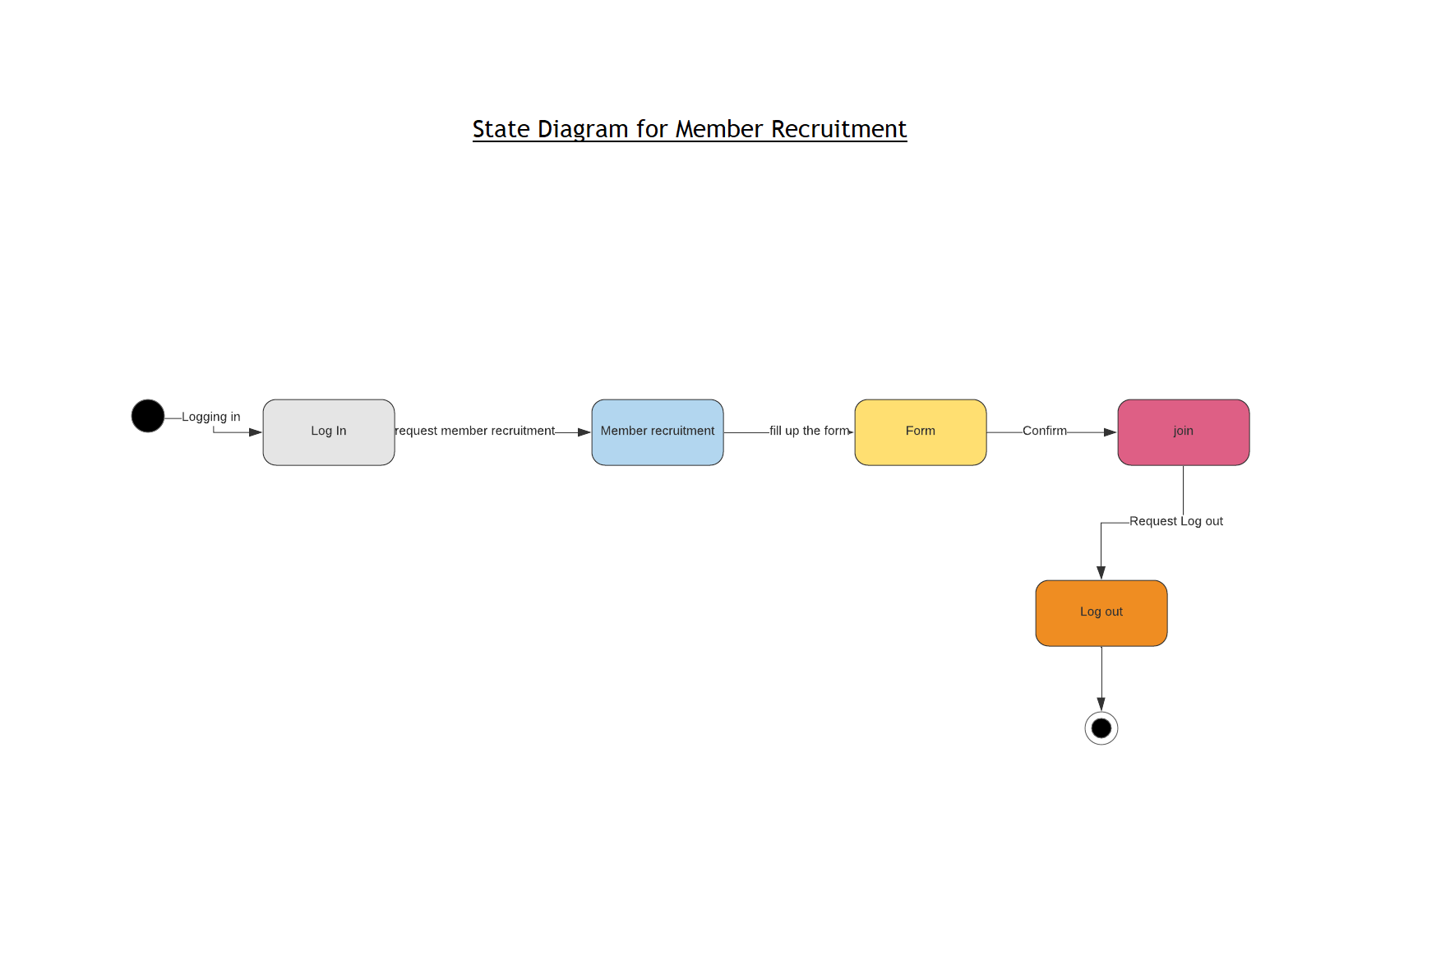
State Diagram

Slide 26
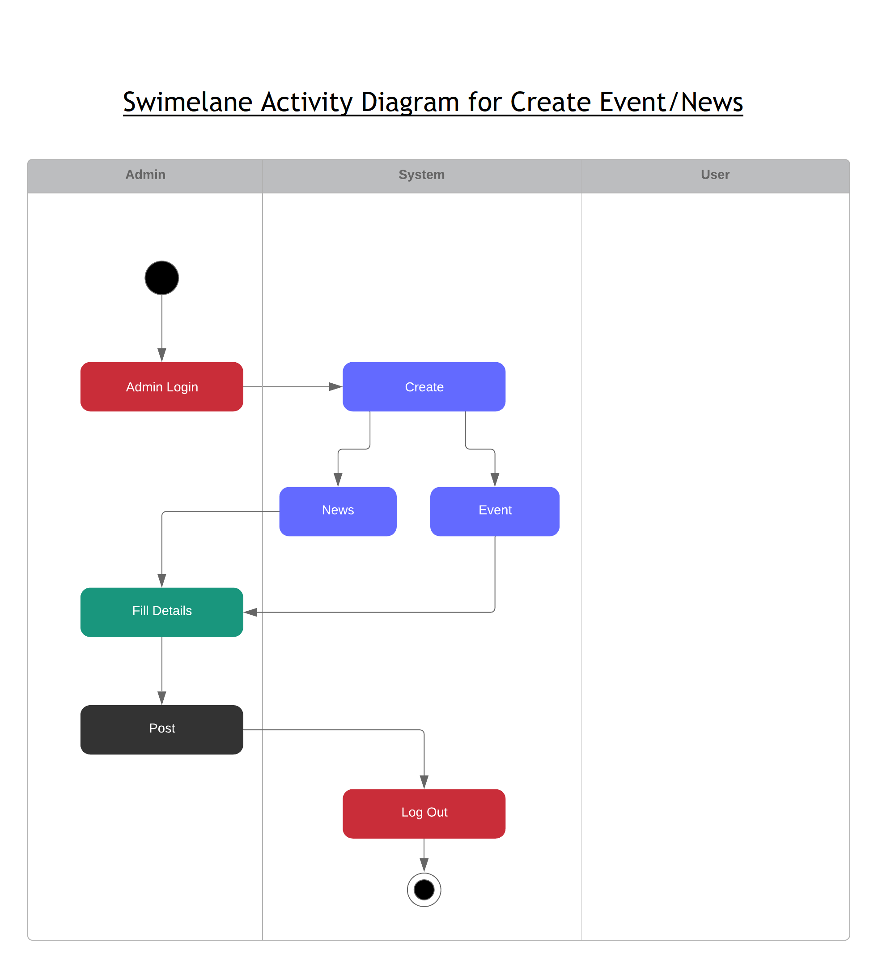
Swimlane Activity Diagram

Slide 27
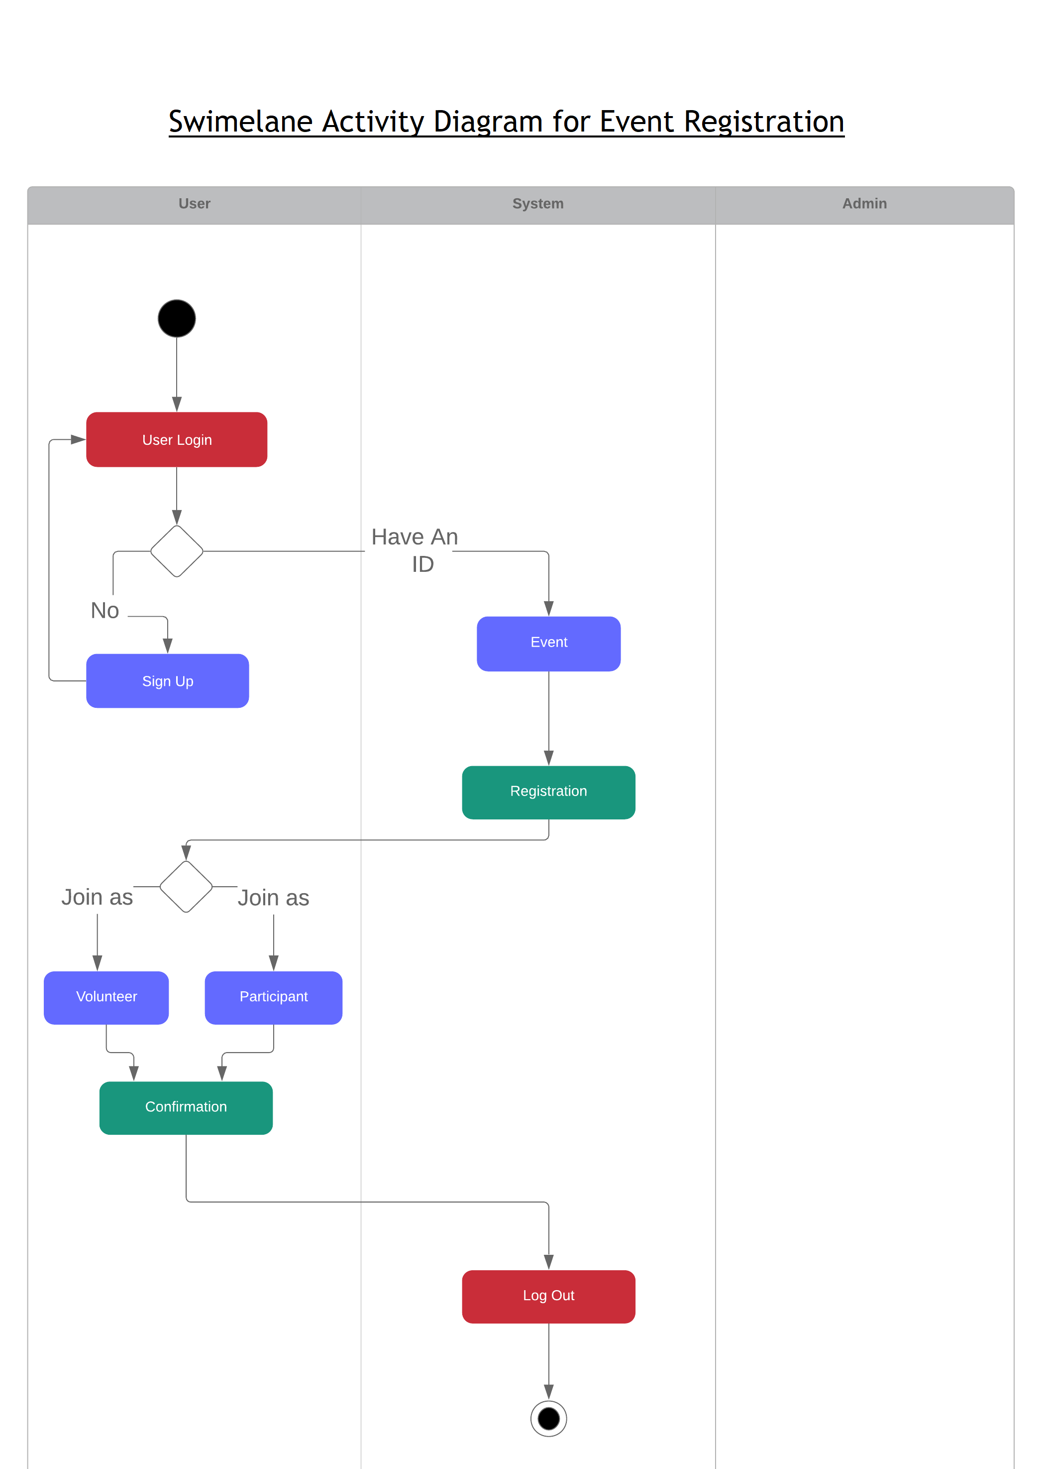
Swimlane Activity Diagram

Slide 28
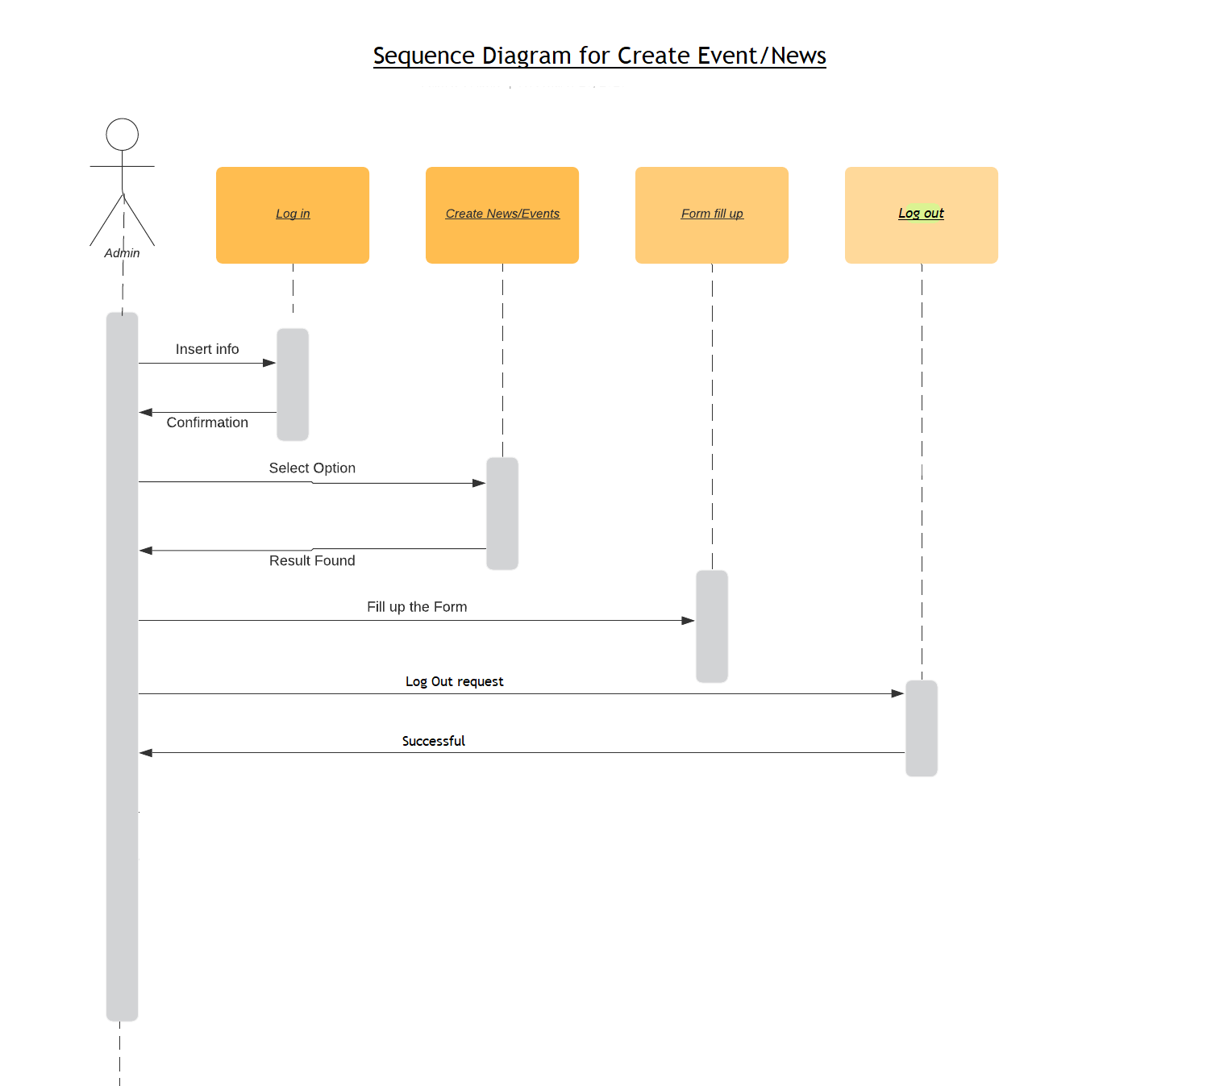
Sequence Diagram

Slide 29
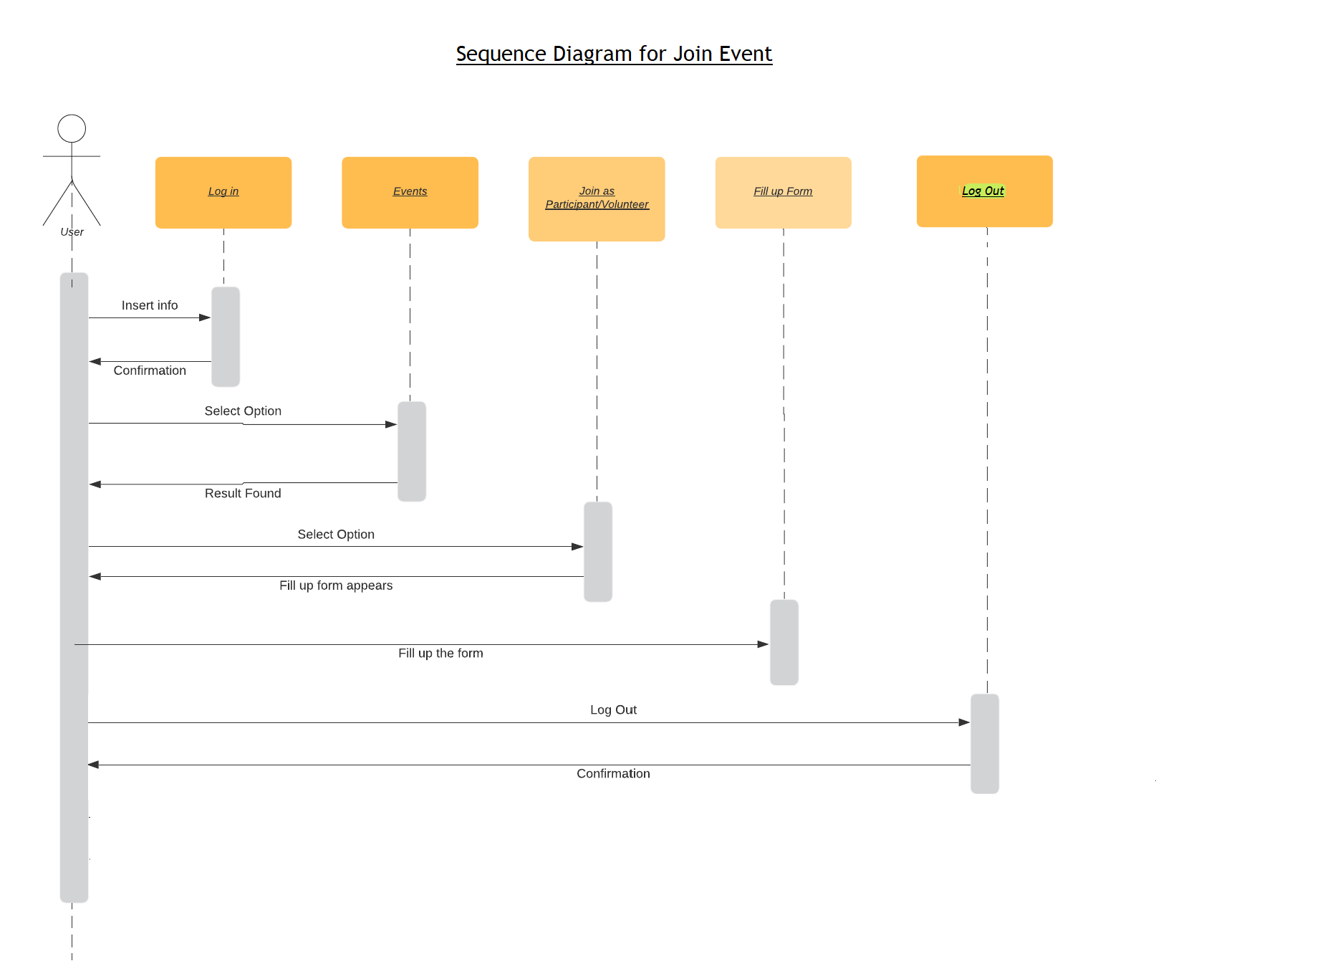
Sequence Diagram

Slide 30
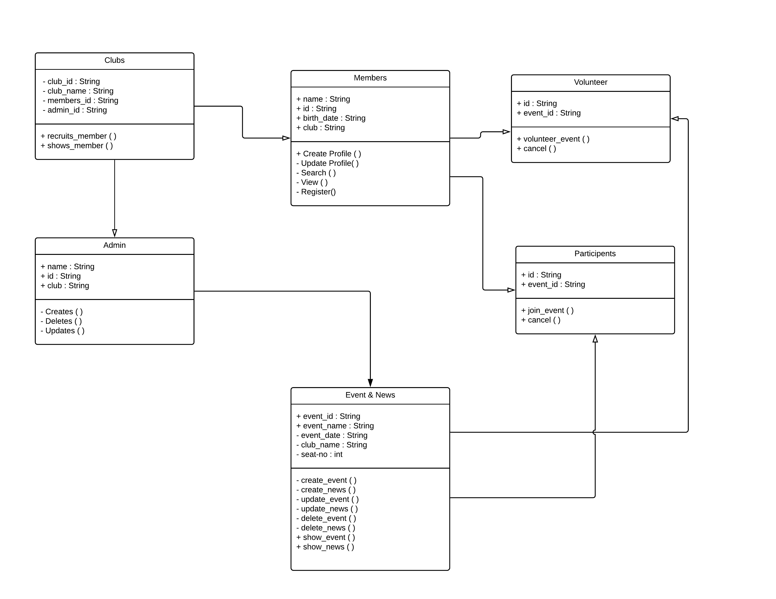
Class Diagram

Slide 31
PROJECT SCREENSHOTS

Slide 32
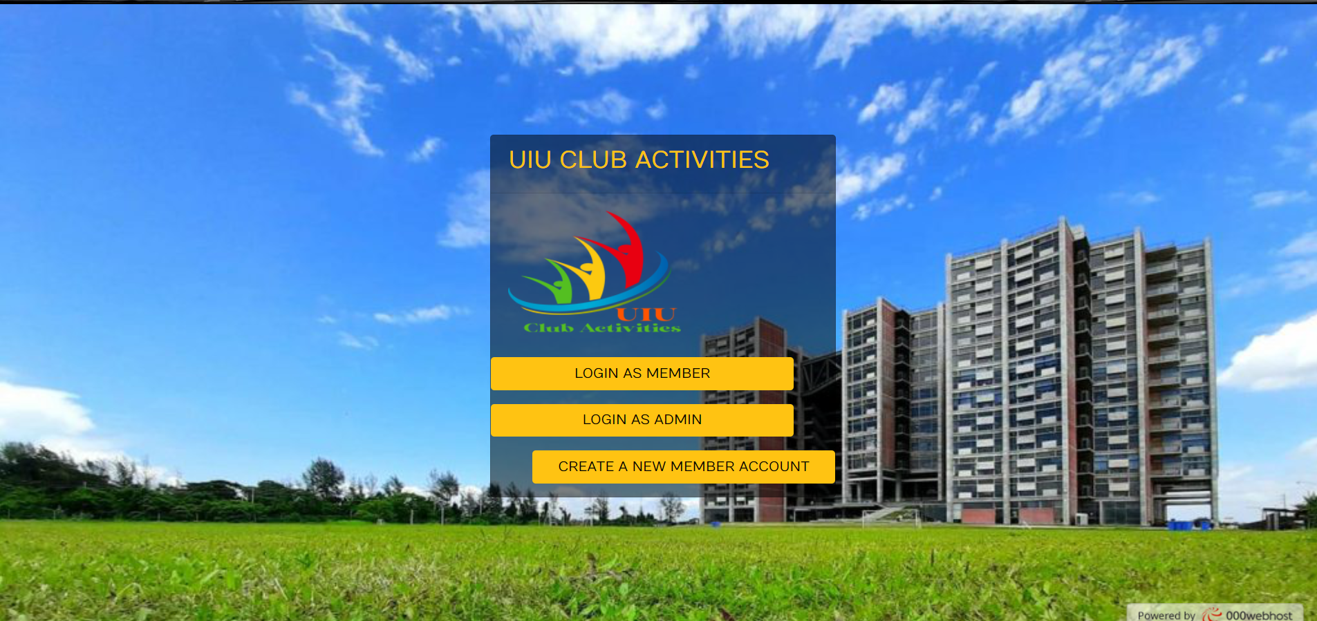
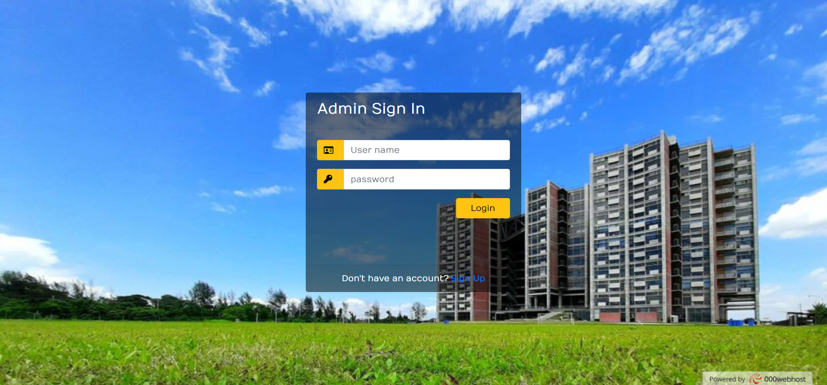
FIRST PAGE
ADMIN
LOGIN

Slide 33
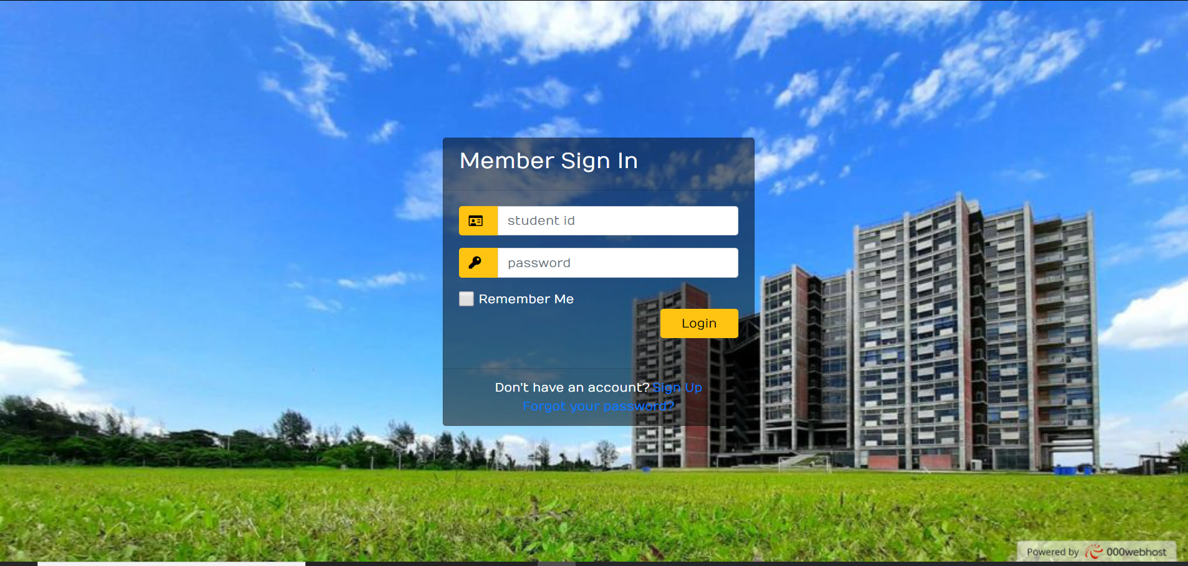
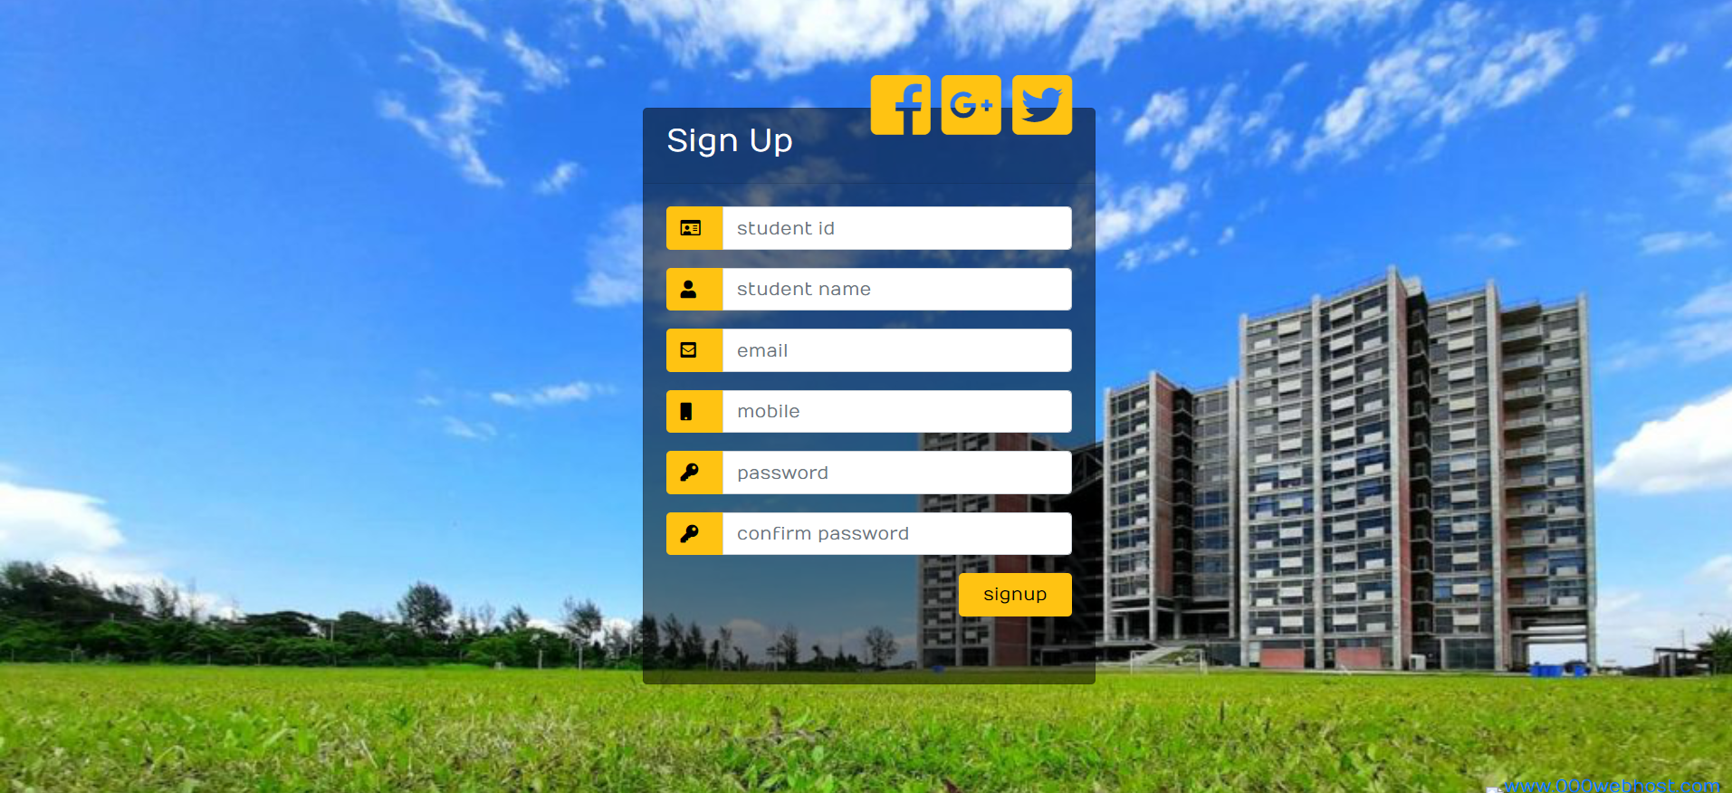
MEMBER
LOGIN
MEMBER
SIGNUP

Slide 34

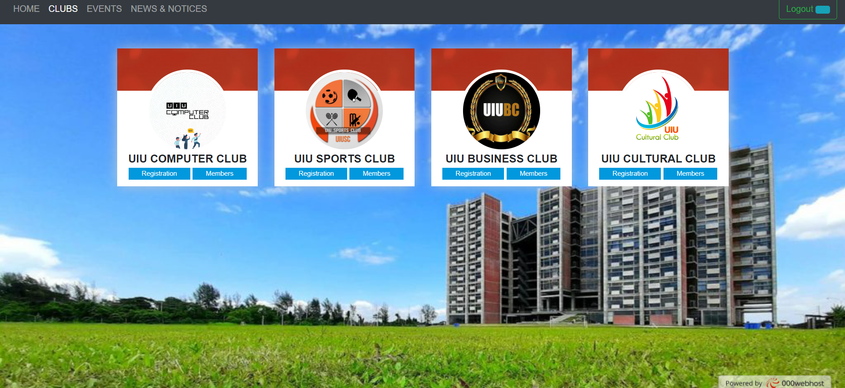
HOME
PAGE
CLUBS
PAGE

Slide 35
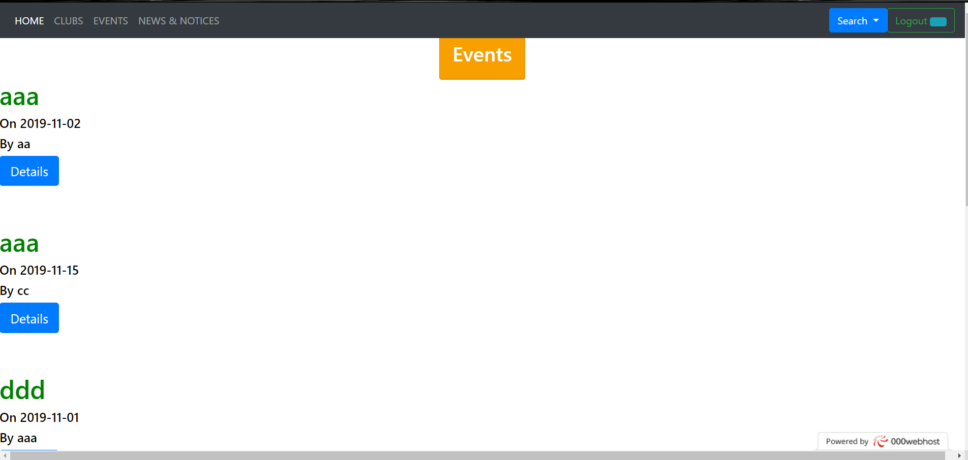
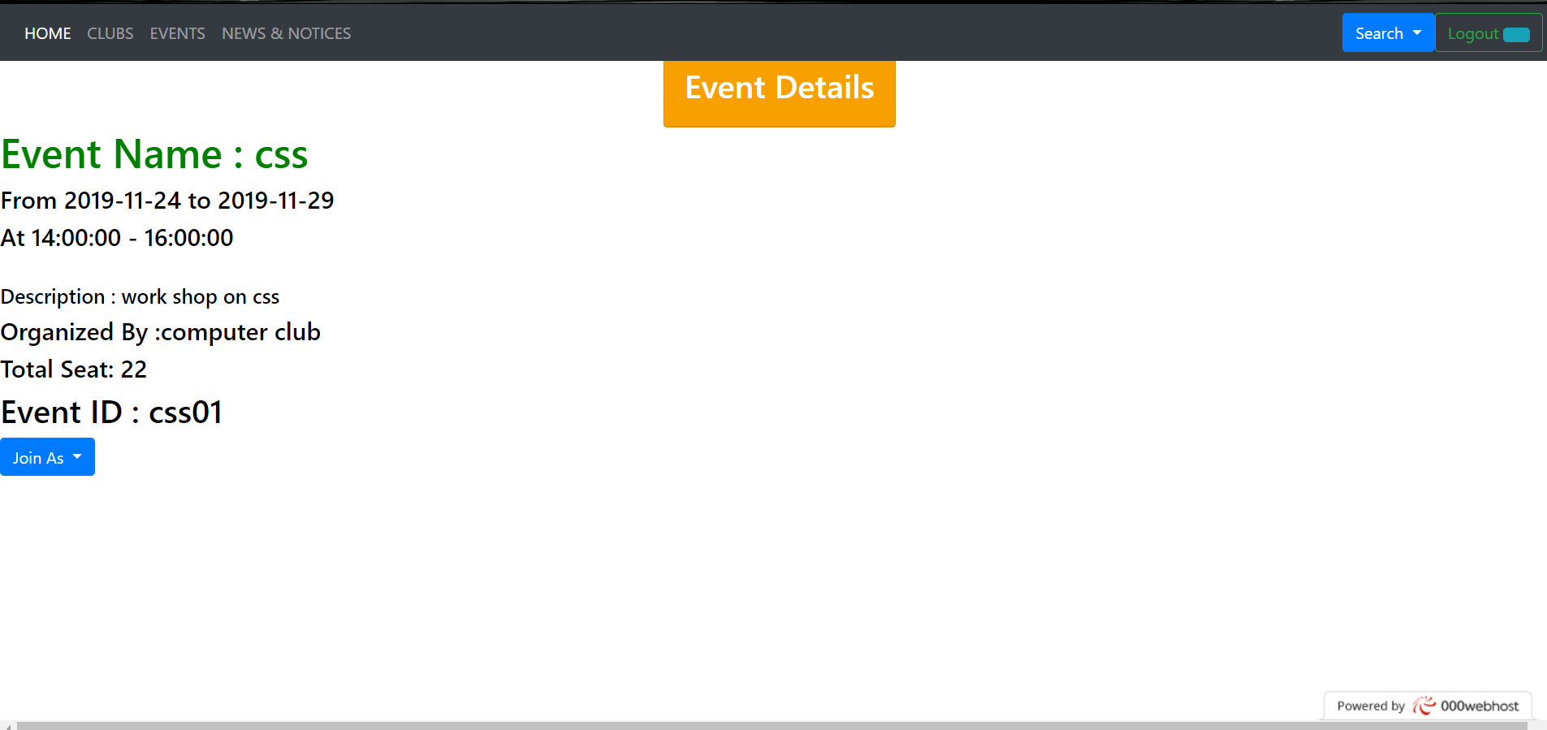
EVENTS
PAGE
EVENT
DETAILS

Slide 36
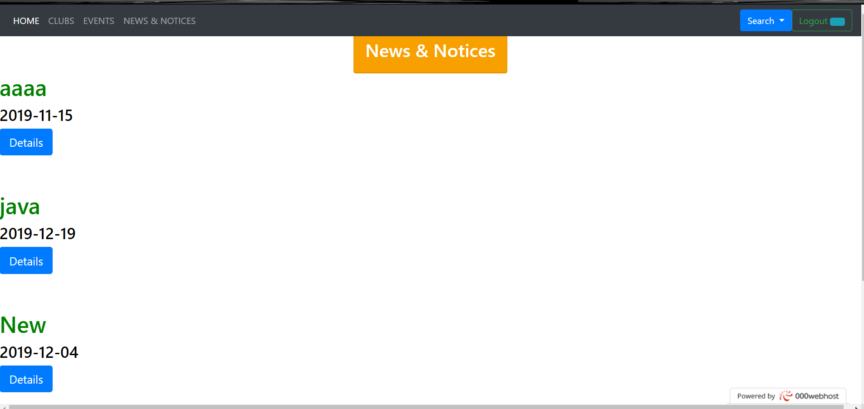
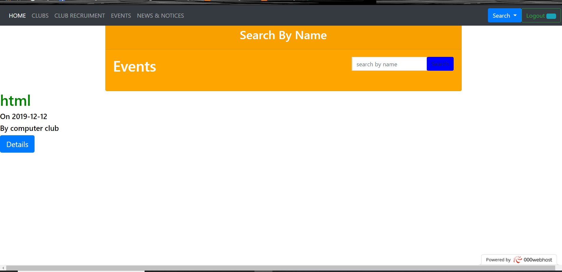
NEWS
PAGE
SEARCH
PAGE

Slide 37
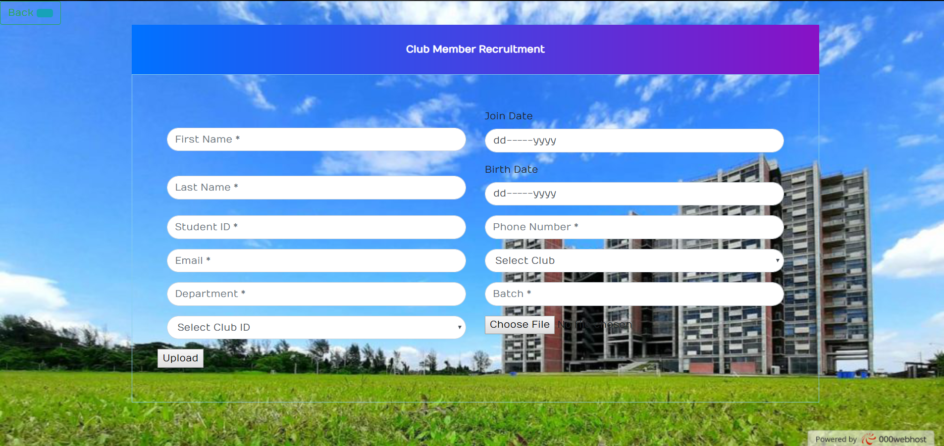
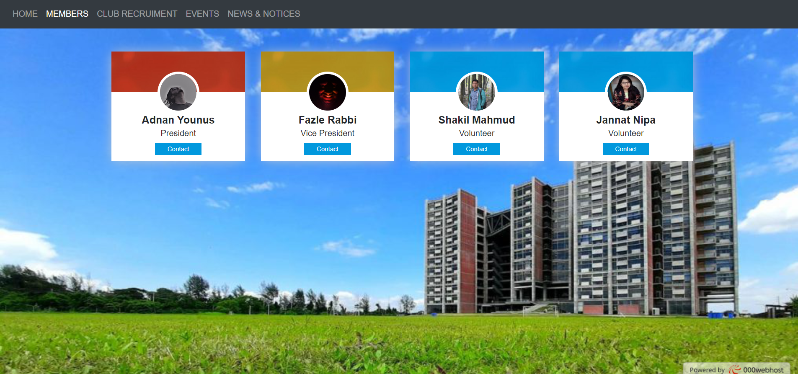
MEMBER
RECRUITMENT
MEMBERS

Slide 38
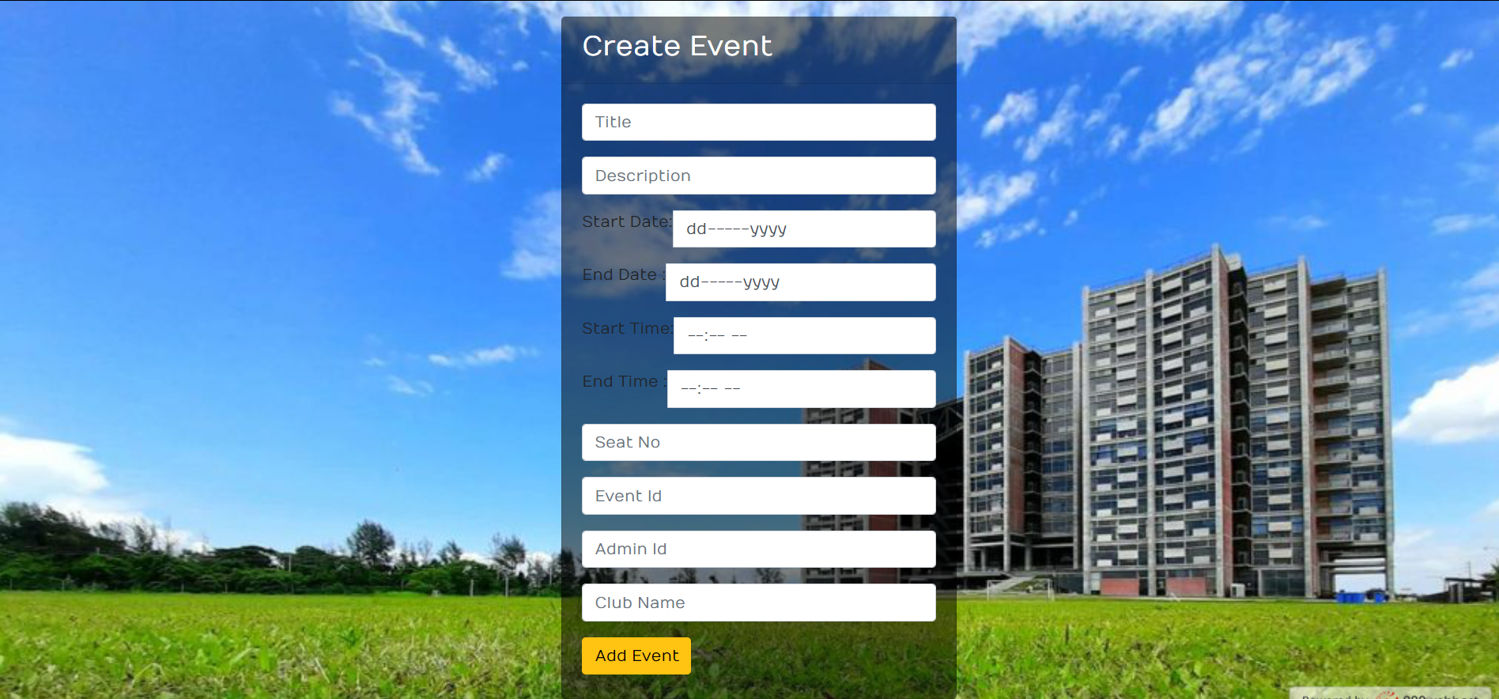
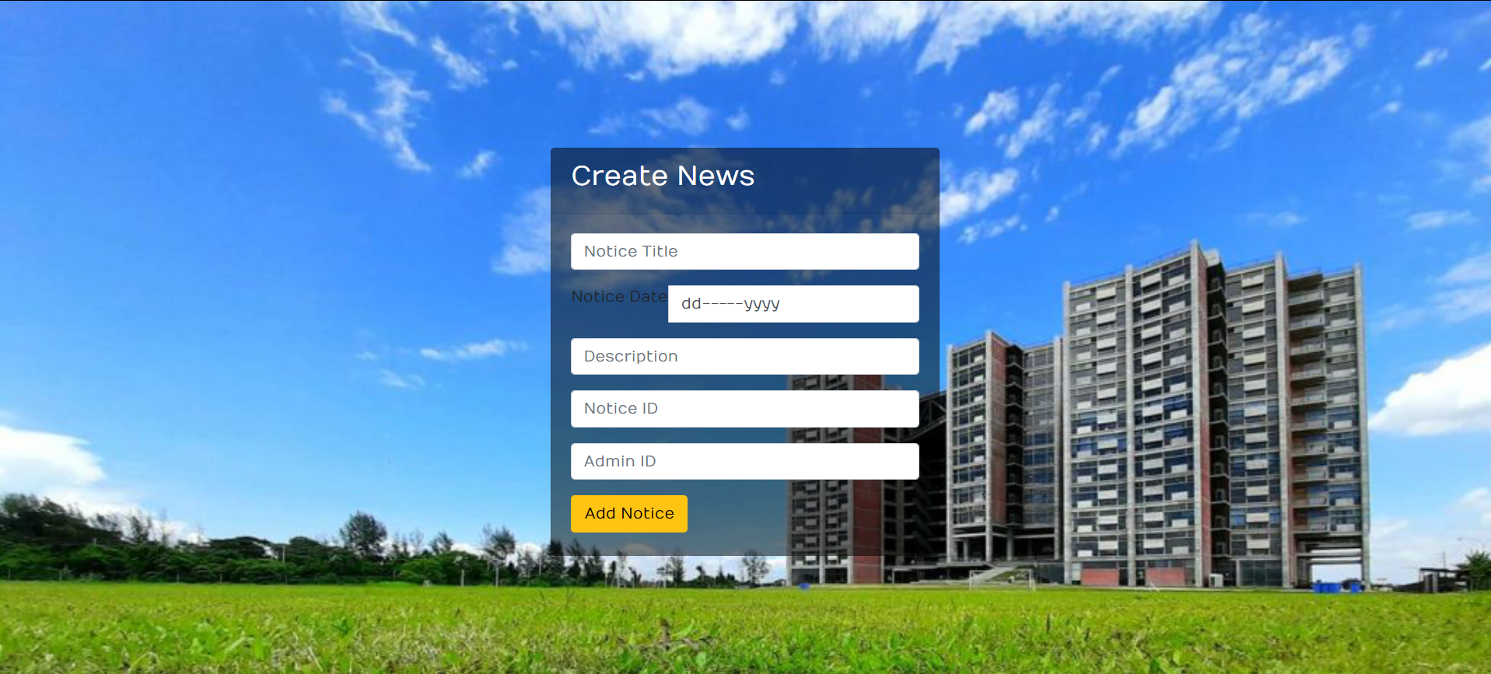
CREATE EVENT
CREATE
NEWS

Slide 39
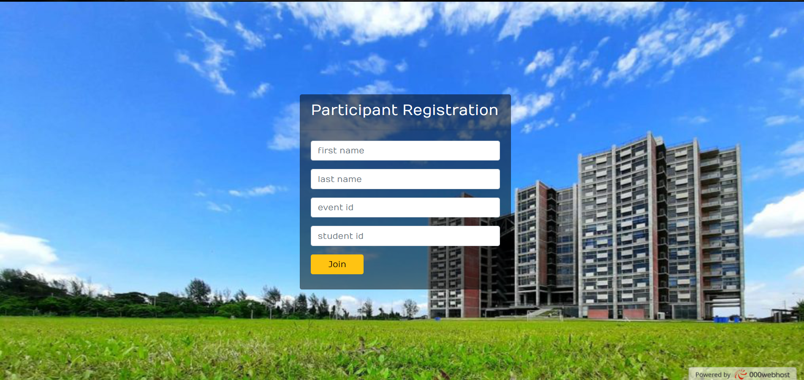
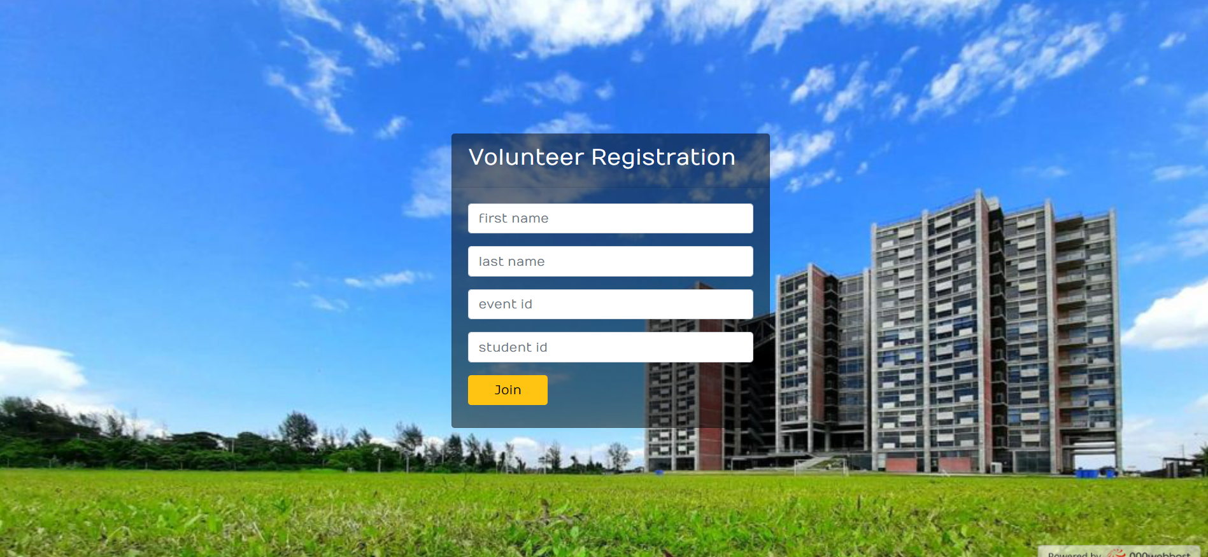
PARTICIPANT
PAGE
VOLUNTEER
PAGE

Slide 40
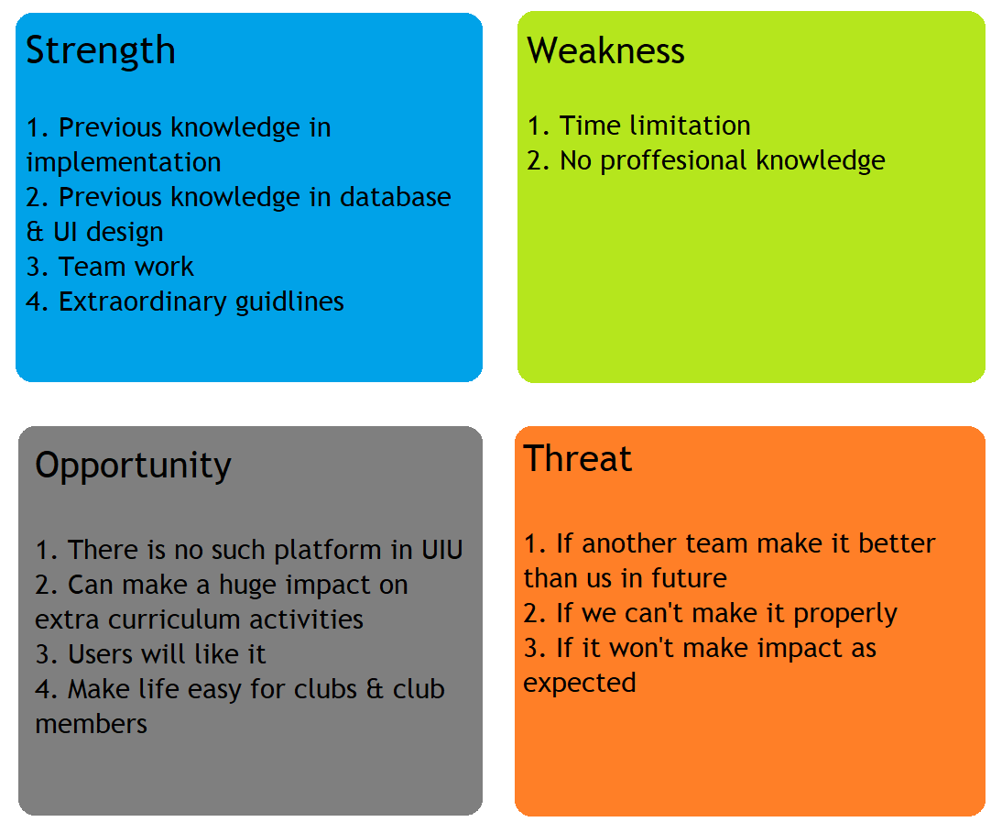
SWOT Analysis

Slide 41
Tools
Hosting
000webhost.com
Backend
PHP
Frontend
CSS
HTML
BOOTSTRAP
Diagrams
Lucidchart

Slide 42
Contribution
IDEA:ADNAN YOUNUS,FAZLE RABBI FERDAUS
BENCHMARKS: ADNAN YOUNUS
MOCK UP/UI DESIGN: SHAKIL MAHMUD, ADNAN YOUNUS
PROJECT MANAGEMENT TOOL:SHAKIL MAHMUD
SLIDE:ADNAN YOUNUS,FAZLE RABBI FERDAUS
DIAGRAMS: FAZLE RABBI FERDAUS, ADNAN YOUNUS
BACKEND: ADNAN YOUNUS, FAZLE RABBI FERDAUS
FRONTEND: SHAKIL MAHMUD, ADNAN YOUNUS
HOSTING: FAZLE RABBI FERDAUS

Slide 43
Muchas Gracias Thank You

